Slide 1
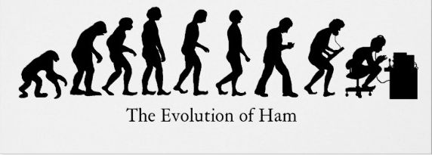
Digital Voice A brief look
By
Lynn Wilson, K7LW

Slide 2
Not here to convert anyone, It’s okay to stick with Analog FM!

Slide 3
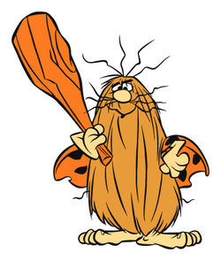
AM Signal AKA “Ancient Mode.”

Slide 4
FM Signal “Frequency Deviation”

Slide 5
Digital Signal

Slide 6
What is Digital Voice?
•Digital data modulating an RF carrier
•The data is digitized audio from an A/D converter
•It is processed through a vocoder to compress the data and add forward error correction
•The data is sent serially in uniform length packets
•Header data is pre-pended to provide sync bits, routing instructions and user identity
•Other data is often interleaved or substituted for the voice to send text, pictures or other files

Slide 7
Digital Sampling

Slide 8
Packet Structure

Slide 9
Bandwidth Comparison

Slide 10
Analog Compared to Digital Range
Digital Voice retains better quality than analog as signal strength decreases.

Slide 11
D-Star Basic System

Slide 12
D-Star Stations REF029A

Slide 13
C4FM/WiresX

Slide 14
WiresX Structure

Slide 15
Nodes Attached to Room

Slide 16
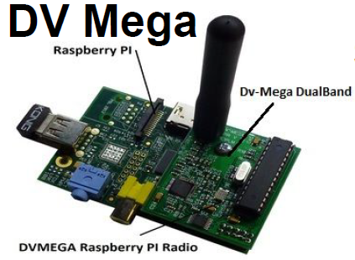
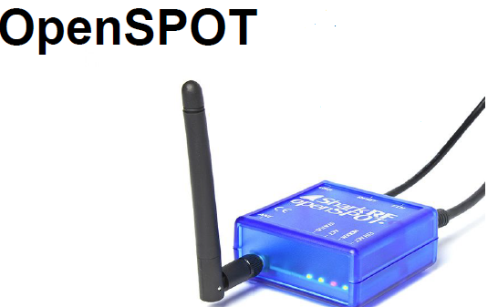
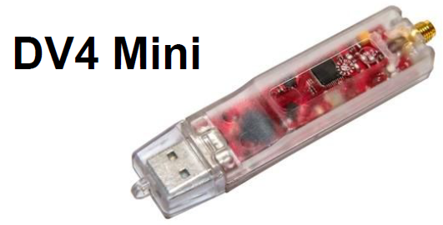
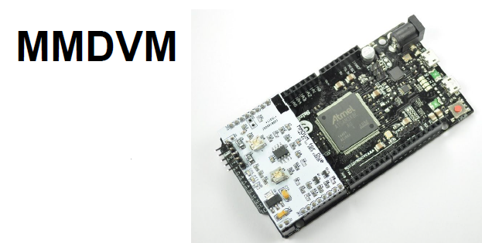
Hot Spots

